Slide 1
Face Recognition for The Department
CE712 Course Project, Autumn 2019
Under the guidance of Prof. Indu J.
Team Members: Vachika(140040082), Saurabh(16d100018)

Slide 2
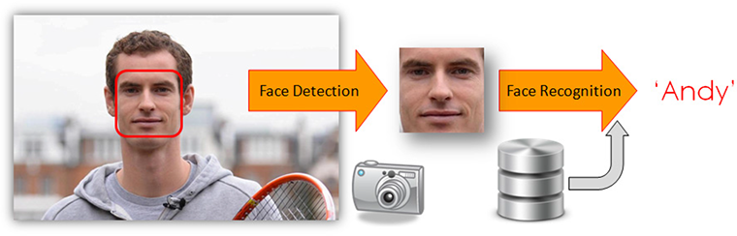
Project Overview
Given an image, task is to detect and label the individual in the image

Slide 3
Approach
Face Recognition
Locate Face
Encode
Compare

Slide 4
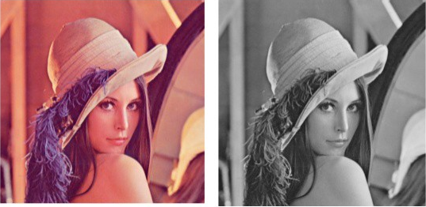
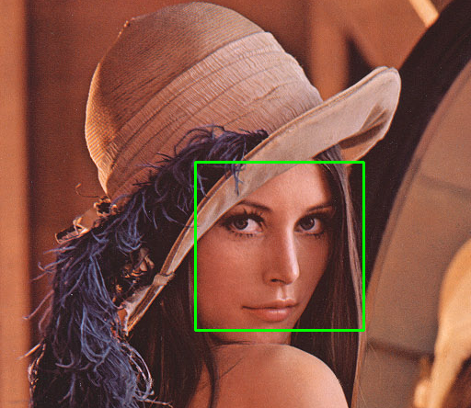
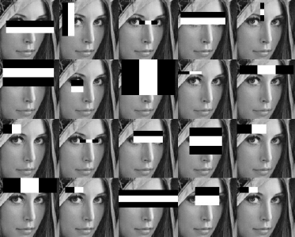
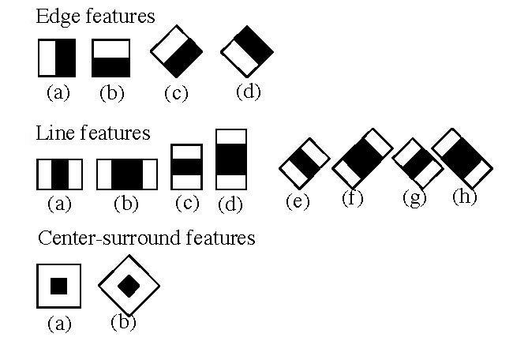
Locating Face

Slide 5
Encoding the located face
The encodings can be of various features like:
Height/width of the face.
Height and width may not be reliable since the image could be rescaled to a smaller face. However, even after rescaling, what remains unchanged are the ratios – the ratio of height of the face to the width of the face won’t change.
Color of the face.
Width of other parts of the face like lips, nose, etc.
Essentially, given an image, we can map out various features and convert it into a feature vector like:
Height of face (cm) | Width of face (cm) | Average color of face (RGB) | Width of lips (cm) | Height of nose (cm)
23.1 | 15.8 | (255, 224, 189) | 5.2 | 4.4

Slide 6
Compare with database
Known
Compare the two
Current Face Encoding
Label
Known Face Encodings
Unknown

Slide 7
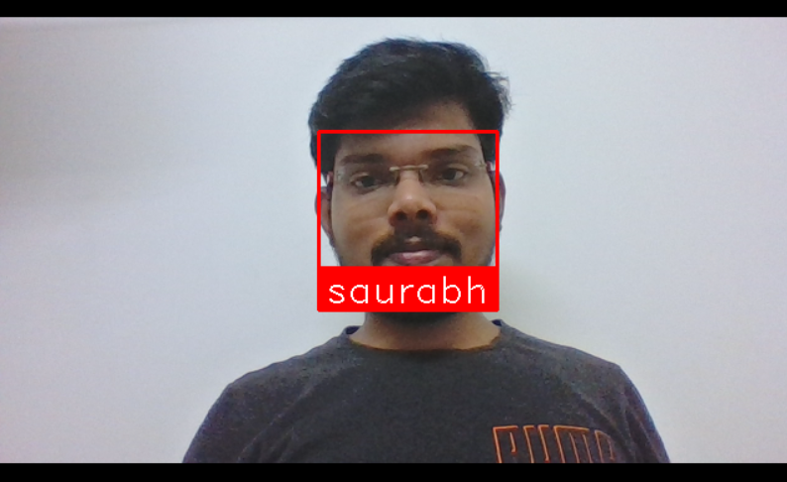
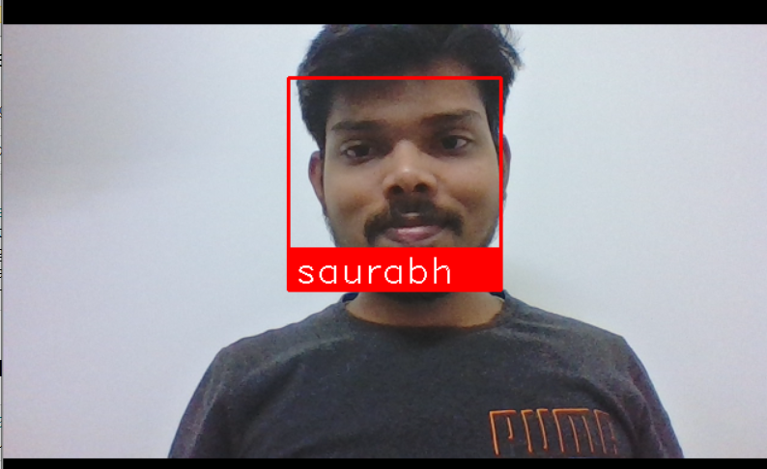
Sample Output
With Spectacles
Without Spectacles

Slide 8
Applications
Filter access (To specific people and for specific time also)
Attendance system(mark attendance of people present in a class)
Mark criminals roaming out freely

